Slide 1
Forms and PHP
M. Premalatha, AP[SG], SCSE,
VIT University, Chennai

Slide 2
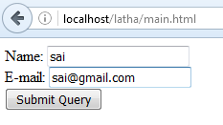
Example 1: main.html
<html> <body> <form action="welcome.php" method="post"> Name: <input type="text" name="name"><br> E-mail: <input type="text" name="email"><br> <input type="submit"> </form> </body> </html>

Slide 3
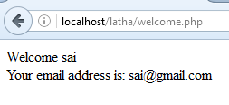
welcome.php
<html> <body> Welcome <?php echo $_POST["name"]; ?><br> Your email address is: <?php echo $_POST["email"]; ?> </body> </html>

Slide 4
Example2: form1.html
<head>
<title>Sample form to take user input in XHTML</title>
</head>
<body>
<h1>This is a sample registration form.</h1>
Please fill in all fields and click Register.
<!-- post form data to form2.php -->
<form method = "post" action = "form2.php">
<br />
<span style = "color: blue">
Please fill out the fields below.<br />
</span>
<!-- create four text boxes for user input -->
<img src = "images/fname.gif" alt = "First Name" />
<input type = "text" name = "fname" /><br />
<img src = "images/lname.gif" alt = "Last Name" />
<input type = "text" name = "lname" /><br />

Slide 5
Example2: form1.html
<img src = "images/email.gif" alt = "Email" />
<input type = "text" name = "email" /><br />
<img src = "images/phone.gif" alt = "Phone" />
<input type = "text" name = "phone" /><br />
<span style = "font-size: 10pt">
Must be in the form (555)555-5555</span>
<br /><br />
<span style = "color: blue">
Which book would you like information about?
</span><br/>
<!-- create drop-down list containing book names-->
<select name = "book">
<option>Internet and WWW How to Program 2e</option>
<option>C++ How to Program 3e</option>
<option>Java How to Program 4e</option>
<option>XML How to Program 1e</option>
</select>

Slide 6
Example2: form1.html
<br /><br />
<br /><span style = "color: blue">
Which operating system are you currently using?
<br /></span>
<!-- create five radio buttons -->
<input type = "radio" name = "os" value = "Windows NT" checked = "checked”/> Windows NT
<input type = "radio" name = "os" value = "Windows 2000" /> Windows 2000
<input type = "radio" name = "os" value = "Windows 98" /> Windows 98<br />
<input type = "radio" name = "os" value = "Linux" /> Linux
<input type = "radio" name = "os" value = "Other" /> Other<br />
<br />
<!-- create a submit button -->
<input type = "submit" value = "Register" />
</form>
</body>

Slide 7
Form2.php
<head>
<title>Form Validation</title>
</head>
<body style = "font-family: arial,sans-serif">
<p>Hi
<span style = "color: blue">
<strong>
<?php echo $_POST["fname"]; ?>
</strong>
</span>.
Thank you for completing the survey.<br />
You have been added to the
<span style = "color: blue">
<strong>
<?php echo $_POST["book"]; ?>
</strong>
</span>
mailing list.
</p>

Slide 8
Form2.php
<strong>The following information has been saved in our database:</strong><br />
<table border = "2" cellpadding = "0" cellspacing = "10">
<tr>
<td bgcolor = "#ffffaa">Name </td>
<td bgcolor = "#ffffbb">Email</td>
<td bgcolor = "#ffffcc">Phone</td>
<td bgcolor = "#ffffdd">OS</td>
</tr>
<tr>
<?php
$a=$_POST["fname"];
$b=$_POST["email"];
$c=$_POST["phone"];
$d=$_POST["os"];

Slide 9
Form2.php
// print each form field’s value
echo "<td>$a</td>
<td>$b</td>
<td>$c</td>
<td>$d</td>";
?>
</tr>
</table>
<br /><br /><br />
<div style = "font-size: 10pt; text-align: center">76 This is only a sample form. You have not been added to a mailing list.
</div>
</body>

Slide 10
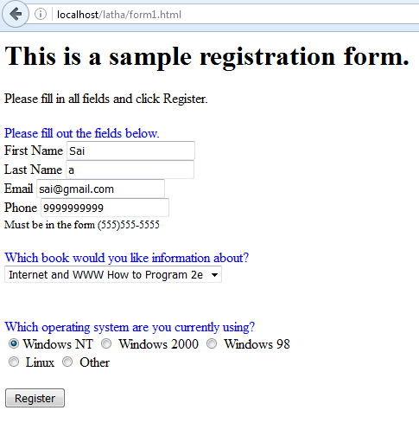

Slide 11
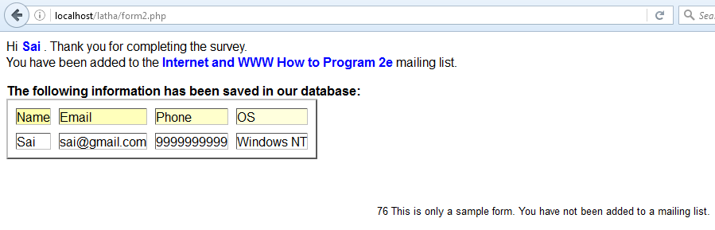

Slide 12
PHP – Regular Expressions
preg_match is the keyword used for matching characters using regular expressions in php
The preg_match() function searches a string for pattern, returning true if the pattern exists, and false otherwise.
Validate Name:
$name = test_input($_POST["name"]); if (!preg_match("/^[a-zA-Z ]*$/",$name)) { $nameErr = "Only letters and white space allowed"; }

Slide 13
PHP – Regular Expressions
Validate E-mail
$email = test_input($_POST["email"]); if (!filter_var($email, FILTER_VALIDATE_EMAIL)) { $emailErr = "Invalid email format"; }
Validate URL
$website = test_input($_POST["website"]); if (!preg_match("/\b(?:(?:https?|ftp):\/\/|www\.)[-a-z0-9+&@#\/%?=~_|!:,.;]*[-a-z0-9+&@#\/%=~_|]/i",$website)) { $websiteErr = "Invalid URL"; }

Slide 14
PHP – Regular Expressions
Validate E-mail
$email = test_input($_POST["email"]); if (!filter_var($email, FILTER_VALIDATE_EMAIL)) { $emailErr = "Invalid email format"; }
Validate URL
$website = test_input($_POST["website"]); if (!preg_match("/\b(?:(?:https?|ftp):\/\/|www\.)[-a-z0-9+&@#\/%?=~_|!:,.;]*[-a-z0-9+&@#\/%=~_|]/i",$website)) { $websiteErr = "Invalid URL"; }

Slide 15
Form Validation:
<head>
<style>
.error {color: #FF0000;}
</style>
</head>
<body>
<?php
// define variables and set to empty values
$nameErr = $emailErr = $genderErr = $websiteErr = "";
$name = $email = $gender = $comment = $website = "";
if ($_SERVER["REQUEST_METHOD"] == "POST") {
if (empty($_POST["name"])) {
$nameErr = "Name is required";
} else {
$name = test_input($_POST["name"]);
// check if name only contains letters and whitespace
if (!preg_match("/^[a-zA-Z ]*$/",$name)) {
$nameErr = "Only letters and white space allowed";
} }

Slide 16
Form Validation:
if (empty($_POST["email"])) {
$emailErr = "Email is required";
} else {
$email = test_input($_POST["email"]);
// check if e-mail address is well-formed
if (!filter_var($email, FILTER_VALIDATE_EMAIL)) {
$emailErr = "Invalid email format";
}
}
if (empty($_POST["website"])) {
$website = "“; } else {
$website = test_input($_POST["website"]);
// check if URL address syntax is valid (this regular expression also allows dashes in the URL)
if (!preg_match("/\b(?:(?:https?|ftp):\/\/|www\.)[-a-z0-9+&@#\/%?=~_|!:,.;]*[-a-z0-9+&@#\/%=~_|]/i",$website)) {
$websiteErr = "Invalid URL";
}
}

Slide 17
Form Validation:
if (empty($_POST["comment"])) {
$comment = "";
} else {
$comment = test_input($_POST["comment"]);
}
if (empty($_POST["gender"])) {
$genderErr = "Gender is required";
} else {
$gender = test_input($_POST["gender"]);
}
}
function test_input($data) {
$data = trim($data);
$data = stripslashes($data);
$data = htmlspecialchars($data);
return $data;
}
?>

Slide 18
Form Validation:
<h2>PHP Form Validation Example</h2>
<p><span class="error">* required field.</span></p>
<form method="post" action="<?php echo htmlspecialchars
($_SERVER["PHP_SELF"]);?>">
Name: <input type="text" name="name" value="<?php echo $name;?>">
<span class="error">* <?php echo $nameErr;?></span>
<br><br>
E-mail: <input type="text" name="email" value="<?php echo $email;?>">
<span class="error">* <?php echo $emailErr;?></span>
<br><br>
Website: <input type="text" name="website" value="<?php echo $website;?>">
<span class="error"><?php echo $websiteErr;?></span>
<br><br>

Slide 19
Form Validation:
Comment: <textarea name="comment" rows="5" cols="40"><?php
echo $comment;?></textarea>
<br><br>
Gender:
<input type="radio" name="gender" <?php if (isset($gender)
&& $gender=="female") echo "checked";?> value="female">Female
<input type="radio" name="gender" <?php if (isset($gender)
&& $gender=="male") echo "checked";?> value="male">Male
<span class="error">* <?php echo $genderErr;?></span>
<br><br>
<input type="submit" name="submit" value="Submit">
</form>

Slide 20
Form Validation:
<?php
echo "<h2>Your Input:</h2>";
echo $name;
echo "<br>";
echo $email;
echo "<br>";
echo $website;
echo "<br>";
echo $comment;
echo "<br>";
echo $gender;
?>

Slide 21
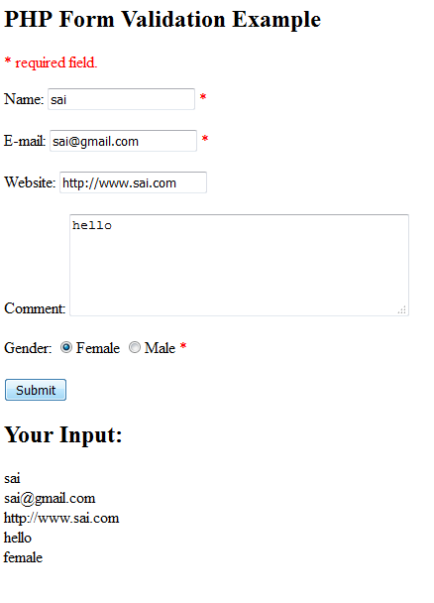

Slide 22
References:
www.w3schools.com/php/

